Slide 1
Managing Array of SSDs When the Storage Device is
No Longer the Performance Bottleneck
Byungseok Kim, Jasho Kim, Sam H.Noh
HotStorage 2017

Slide 2
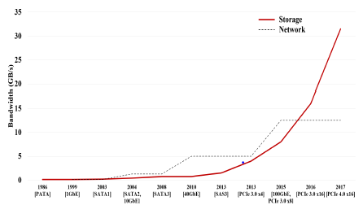
Motivation
The bandwidth of the network that connects clients to storage servers is now being surpassed by storage bandwidth.
Network and storage bandwidth growth trend
Even though SSD arrays employ a large number of SSDs, reports have shown that they do not provide high, stable performance.
→ The major source of such ineffectiveness is the effect of garbage collection(GC) operations within the SSD devices.
The goal is to provide high, sustained and consistent write performance in such a storage environment.
EMSOFT 2016

Slide 3
Serial Management of SSD Arrays
A storage organization for SSD arrays that totally eliminates garbage collection within an SSD.
Storage systems are connected through the network
The storage device is no longer the bottleneck, but the network bandwidth is.
→ Network bandwidth performance should be the target performance goal for SSD arrays.
EMSOFT 2016

Slide 4
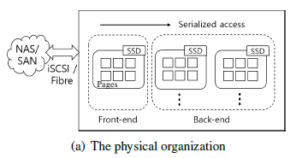
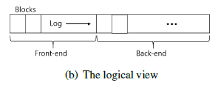
Serial Management of SSD Arrays
Proposed organization can be viewed as a serial sequence of SSDs, where data is written to only one SSD at a time.
Front-end: the SSD serving the write request
Back-end: the rest of SSDs
→ such an organization can be viewed as a sequential list of blocks.
EMSOFT 2016

Slide 5
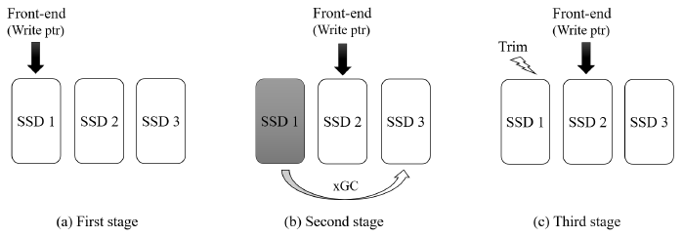
Sequence for handling write request with xGC
First, only the front-end SSD is actively performing writes
Second, no GC occurs within the front-end SSD so that performance is maximized.
Third, when the front-end SSD fills up, it relieves its role as a front-end SSD to one of the back-end SSDs.
Fourth, GC of an SSD occurs not within SSDs, but only among back-end SSDs. (xGC)
EMSOFT 2016

Slide 6
Benefits of Serial Organization
Performance
Write: no GC occurs performance is optimized.
Read: front-end SSD - absorbed by cache in either the client and/or host
back-end SSD - not affected by the front-end SSD write activities
→ define three LRU queues for the pages in DRAM
Efficiency
Less memory space is required to manage the blocks within the FTL.
No OPS space is needed to perform GC.
Longer lifetime can be expected for SSDs.
Wear-leveling becomes simple.
EMSOFT 2016

Slide 7
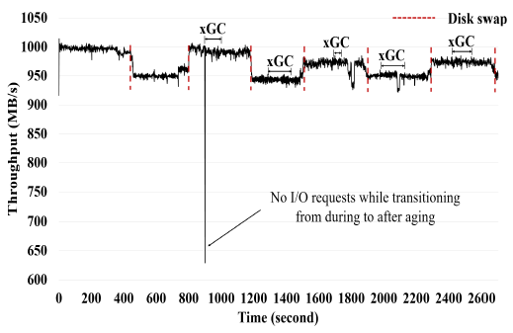
Sustained, Consistent Performance
Proposed organization performance results
There are a slight differences in the bandwidth observed when front-end and back-end SSDs are swapped as a new front-end is selected.
→ most commercial SSDs do not come with exactly the same performance.
xGC does not affect performance.
EMSOFT 2016

Slide 8
Conclusion
Storage devices are no longer the performance bottleneck.
This paper proposes a serial organization for SSD array.
Such serial organization allowed to completely avoid internal garbage collection of SSDs.
Experimental results showed overall high, sustained performance.
EMSOFT 2016

Slide 9
Thank you!
EMSOFT 2016

